Slide 1
CS 570: Data Structures
Collections Framework:
Linked Lists

Slide 2
Single-Linked Lists
A linked list is useful for inserting and removing at arbitrary locations
The ArrayList is limited because its add and remove methods operate in linear (O(n)) time—requiring a loop to shift elements
A linked list can add and remove elements at a known location in O(1) time
In a linked list, instead of an index, each element is linked to the following element

Slide 3
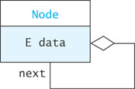
A List Node
A node can contain:
a data item
one or more links
A link is a reference to a list node
In our structure, the node contains a data field named data of type E
and a reference to the next node, named next

Slide 4
List Nodes for Single-Linked Lists
private static class Node<E> {
private E data;
private Node<E> next;
/** Creates a new node with a null next field
@param dataItem The data stored
*/
private Node(E dataItem) {
data = dataItem;
next = null;
}
}

Slide 5
List Nodes for Single-Linked Lists
/** Creates a new node that references another node
@param dataItem The data stored
@param nodeRef The node referenced by new node
*/
private Node(E dataItem, Node<E> nodeRef) {
data = dataItem;
next = nodeRef;
}
}

Slide 6
List Nodes for Single-Linked Lists (cont.)
private static class Node<E> {
private E data;
private Node<E> next;
/** Creates a new node with a null next field
@param dataItem The data stored
*/
private Node(E data) {
data = dataItem;
next = null;
}
The keyword static indicates that the Node<E> class will not reference its outer class
Static inner classes are also called nested classes

Slide 7
List Nodes for Single-Linked Lists (cont.)
private static class Node<E> {
private E data;
private Node<E> next;
/** Creates a new node with a null next field
@param dataItem The data stored
*/
private Node(E dataItem) {
data = dataItem;
next = null;
}
}
Generally, all details of the Node class should be private. This applies also to the data fields and constructors.

Slide 8
Connecting Nodes (cont.)
Node<String> tom = new Node<String>("Tom");
Node<String> bill = new Node<String>(“Bill");
Node<String> harry = new Node<String>("Harry");
Node<String> sam = new Node<String>("Sam");
tom.next = bill;
bill.next = harry;
harry.next = sam;

Slide 9
A Single-Linked List Class
Generally, we do not have individual references to each node
A SingleLinkedList object has a data field head, the list head, which references the first list node
public class SingleLinkedList<E> {
private Node<E> head = null;
private int size = 0;
...
}

Slide 10
SLList: An Example List
SLList<String>
Node<String>
Node<String>
head =
next =
data = "Tom"
next =
data = “Bill"

Slide 11
Implementing SLList.addFirst(E item)
SLList<String>
Node<String>
Node<String>
head =
next =
data = "Tom"
next =
data = “Bill"
Node<String>
next =
data = "Ann"
The element added to the list

Slide 12
Implementing SLList.addFirst(E item) (cont.)
private void addFirst (E item) {
Node<E> temp = new Node<E>(item, head);
head = temp;
size++;
}
or, more simply
private void addFirst (E item) {
head = new Node<E>(item, head);
size++;
}
Notes:
Does the second one work if the list is empty – head is null? – YES
running time? O(1)

Slide 13
Implementing addAfter(Node<E> node, E item)
SLList<String>
Node<String>
Node<String>
head =
next =
data = "Tom"
next =
data = “Bill"
Node<String>
next =
data = "Ann"
The element added to the list

Slide 14
Implementing addAfter(Node<E> node, E item) (cont.)
private void addAfter (Node<E> node, E item) {
Node<E> temp = new Node<E>(item, node.next);
node.next = temp;
size++;
}
or, more simply ...
private void addAfter (Node<E> node, E item) {
node.next = new Node<E>(item, node.next);
size++;
}
We declare this method private since it should not be called from outside the class. Later we will see how this method is used to implement the public add methods.
Notes:
running time? O(1)

Slide 15
Implementing removeAfter(Node<E> node)
temp
SLList<String>
Node<String>
Node<String>
head =
next =
data = "Tom"
next =
data = “Bill"
Node<String>
The Node parameter
next =
data = "Ann"

Slide 16
Implementing removeAfter(Node<E> node) (cont.)
private E removeAfter (Node<E> node) {
Node<E> temp = node.next;
if (temp != null) {
node.next = temp.next;
size--;
return temp.data;
} else {
return null;
}
}
Notes:
running time O(1)

Slide 17
Implementing SLList.removeFirst()
SLList<String>
Node<String>
head =
next =
data = “Bill"
Node<String>
next =
data = "Tom"
temp

Slide 18
Implementing SLList.removeFirst() (cont.)
private E removeFirst () {
Node<E> temp = head;
if (head != null) {
head = head.next;
size--;
return temp.data
} else {
return null;
}
}
Notes:
does this work if we only have one element in the list? -YES

Slide 19
Traversing a Single-Linked List
SLList<String>
Node<String>
Node<String>
head =
next =
data = "Tom"
next =
data = “Bill"
Do something with nodeRef
Do something with nodeRef
Do something with nodeRef
Node<String>
nodeRef
next =
data = "Ann"
null

Slide 20
Traversing a Single-Linked List (cont.)
public String toString() {
Node<String> nodeRef = head;
StringBuilder result = new StringBuilder();
while (nodeRef != null) {
result.append(nodeRef.data);
if (nodeRef.next != null) {
result.append(" ==> ");
}
nodeRef = nodeRef.next;
}
return result.toString();
}

Slide 21
SLList.getNode(int)
In order to implement methods required by the List interface, we need an additional helper method:
private Node<E> getNode(int index) {
Node<E> node = head;
for (int i=0; i<index && node != null; i++) {
node = node.next;
}
return node;
}
Notes:
O(n), while it was O(1) for Arrays, and ArrayLists

Slide 22
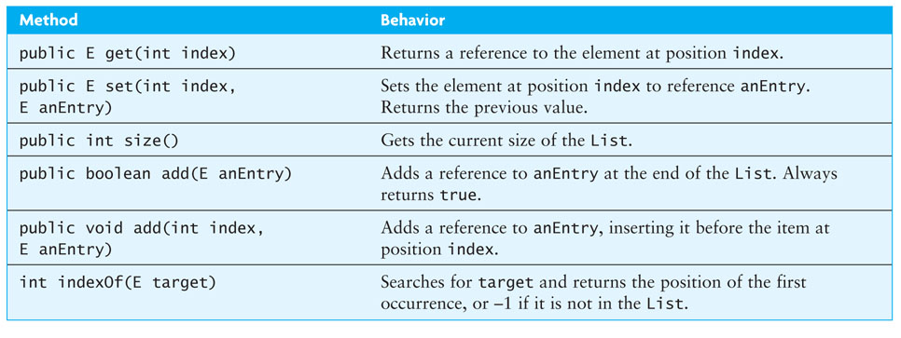
Completing the SingleLinkedList Class
Notes:
public methods. make use of the private ones we saw.

Slide 23
public E get(int index)
public E get (int index) {
if (index < 0 || index >= size) {
throw new IndexOutOfBoundsException(Integer.toString(index));
}
Node<E> node = getNode(index);
return node.data;
}

Slide 24
public E set(int index, E newValue)
public E set (int index, E anEntry) {
if (index < 0 || index >= size) {
throw new IndexOutOfBoundsException(Integer.toString (index));
}
Node<E> node = getNode(index);
E result = node.data;
node.data = newValue;
return result;
}

Slide 25
public void add(int index, E item)
public void add (int index, E item) {
if (index < 0 || index > size) {
throw new
IndexOutOfBoundsException(Integer.toString (index));
}
if (index == 0) {
addFirst(item);
} else {
Node<E> node = getNode(index-1);
addAfter(node, item);
}
}

Slide 26
public boolean add(E item)
To add an item to the end of the list
public boolean add (E item) {
add(size, item);
return true;
}

Slide 27
Performance of SingleLinkedList
The set and get methods:
Inserting or removing general elements:
Adding at the beginning:
Adding at the end:
Notes:
O(n)
O(n), unless we already have a reference to the node
O(1)
O(n)

Slide 28
Double-Linked Lists
Limitations of a singly-linked list include:
Insertion at the front is O(1); insertion at other positions is O(n)
Insertion is convenient only after a referenced node
Removing a node requires a reference to the previous node
We can traverse the list only in the forward direction
We can overcome some of these limitations:
Add a reference in each node to the previous node, creating a double-linked list

Slide 29
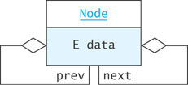
Node Class
private static class Node<E> {
private E data;
private Node<E> next = null;
private Node<E> prev = null;
private Node(E dataItem) {
data = dataItem;
}
}

Slide 30
Inserting into a Double-Linked List
from predecessor
sam
Node
Node
next =
= prev
data = "Harry"
next = null
= prev
data = "Sam"
to predecessor
Node<E> sharon = new Node<E>("Sharon");
sharon.next = sam;
sharon.prev = sam.prev;
sam.prev.next = sharon;
sam.prev = sharon
sharon
Node
next =
= prev
data = "Sharon"

Slide 31
Removing from a Double-Linked List
harry
Node
Node
next =
= prev
data = “Jack"
next =
= prev
data = "Sharon"
Node
harry.prev.next = harry.next
harry.next.prev = harry.prev
next =
= prev
data = "Harry"

Slide 32

A Double-Linked List Class
So far we have worked only with internal nodes
As with the single-linked class, it is best to access the internal nodes with a double-linked list object
A double-linked list object has data fields:
head (a reference to the first list Node)
tail (a reference to the last list Node)
size
Insertion at either end is O(1); insertion elsewhere is still O(n)
Notes:
what about remove?
O(n) if we remove at location(index)
O(1) if we have a reference to the node (not the case for singe linked lists)

Slide 33
Circular Lists
Circular double-linked list:
Link last node to the first node, and
Link first node to the last node
We can also build singly-linked circular lists:
Traverse in forward direction only
Advantages:
Continue to traverse even after passing the first or last node
Visit all elements from any starting point
Never fall off the end of a list
Disadvantage: Code must avoid an infinite loop!

Slide 34
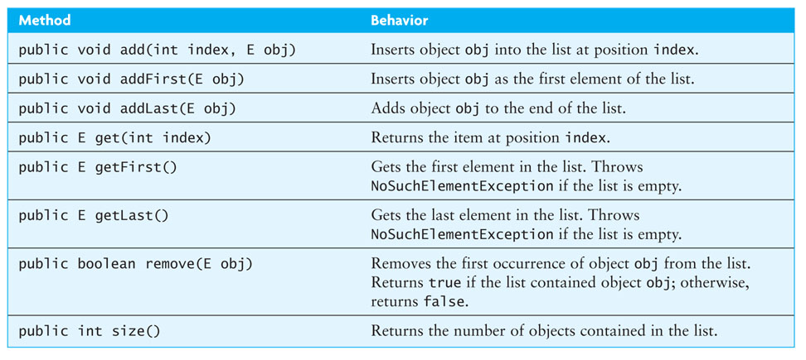
The LinkedList Class

Slide 35
The Iterator
An iterator can be viewed as a moving place marker that keeps track of the current position in a particular linked list
An Iterator object for a list starts at the list head
The programmer can move the Iterator by calling its next method.
The Iterator stays on its current list item until it is needed
An Iterator traverses in O(n) while a list traversal using get() calls in a linked list is O(n²)

Slide 36
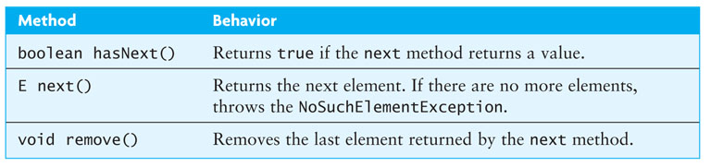
Iterator Interface
The Iterator interface is defined in java.util
The List interface declares the method iterator which returns an Iterator object that iterates over the elements of that list
Notes:
There’s also an add(E obj) method: inserts the specified element into the list (optional operation). The element is inserted immediately before the element that would be returned by next()

Slide 37
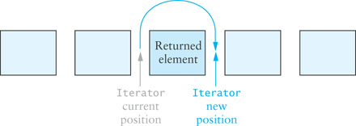
Iterator Interface (cont.)
An Iterator is conceptually between elements; it does not refer to a particular object at any given time

Slide 38
Iterator Interface (cont.)
In the following loop, we process all items in List<Integer> through an Iterator
Iterator<Integer> iter = aList.iterator();
while (iter.hasNext()) {
int value = iter.next();
// Do something with value
...
}

Slide 39
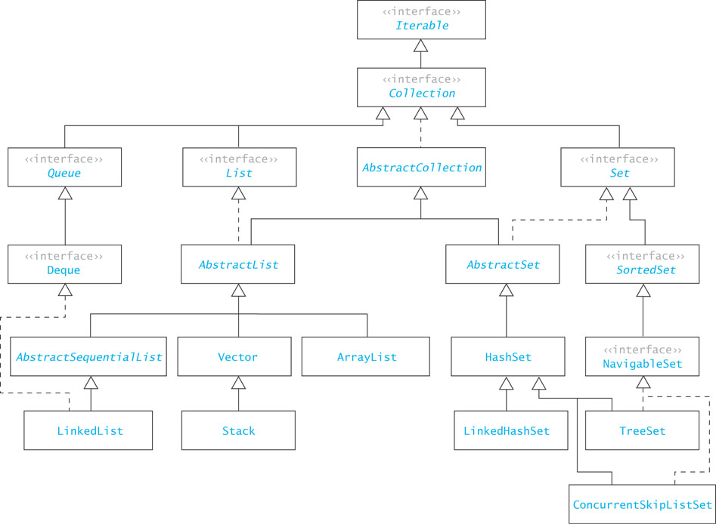
The Collection Framework

Slide 40
Common Features of Collections
Collections
grow as needed
hold references to objects
have at least two constructors: one to create an empty collection and one to make a copy of another collection

